Slide 1
SUBSET – SUM PROBLEM

Slide 2
PROBLEM & GOAL
We are given n items {1, . . . , n}, and each has a given nonnegative weight wi (for i = 1, . . . , n).
We are also given a bound W.
We would like to select a subset S of the items so that ∑i∈S wi ≤ W and, subject to this restriction, ∑i∈S wi is as large as possible.
We will call this the Subset Sum Problem.

Slide 3


DESIGNING THE ALGORITHM
Let us consider and optimal solution.
OPT(n, W) = max profit subset of items 1, …, n with weight limit W.
There can be 2 cases if we consider an nth item as follows
Case 1: OPT does not select item n i.e. n OPT
OPT selects best of { 1, 2, …, n-1 } using weight limit W.
Case 2: OPT selects item n. (i.e. n OPT)
New weight limit = W – wn
OPT selects best of { 1, 2, …, n–1 } using this new weight limit.

Slide 4
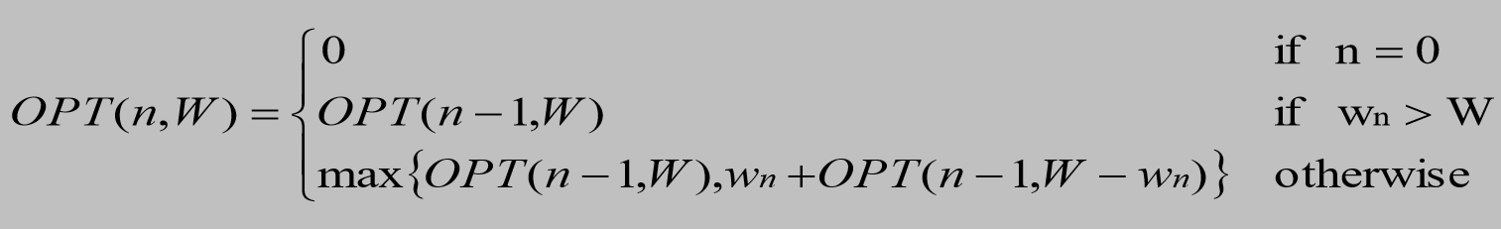
DESIGNING THE ALGORITHM
Recurrence Relation

Slide 5
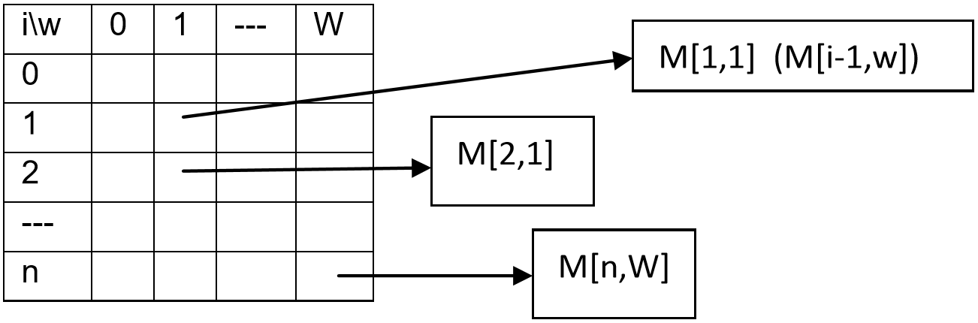
DESIGNING THE ALGORITHM
We need two dimensional table of (n,W) to fill in the values in order to get the maximum subset of weights of the items.

Slide 6
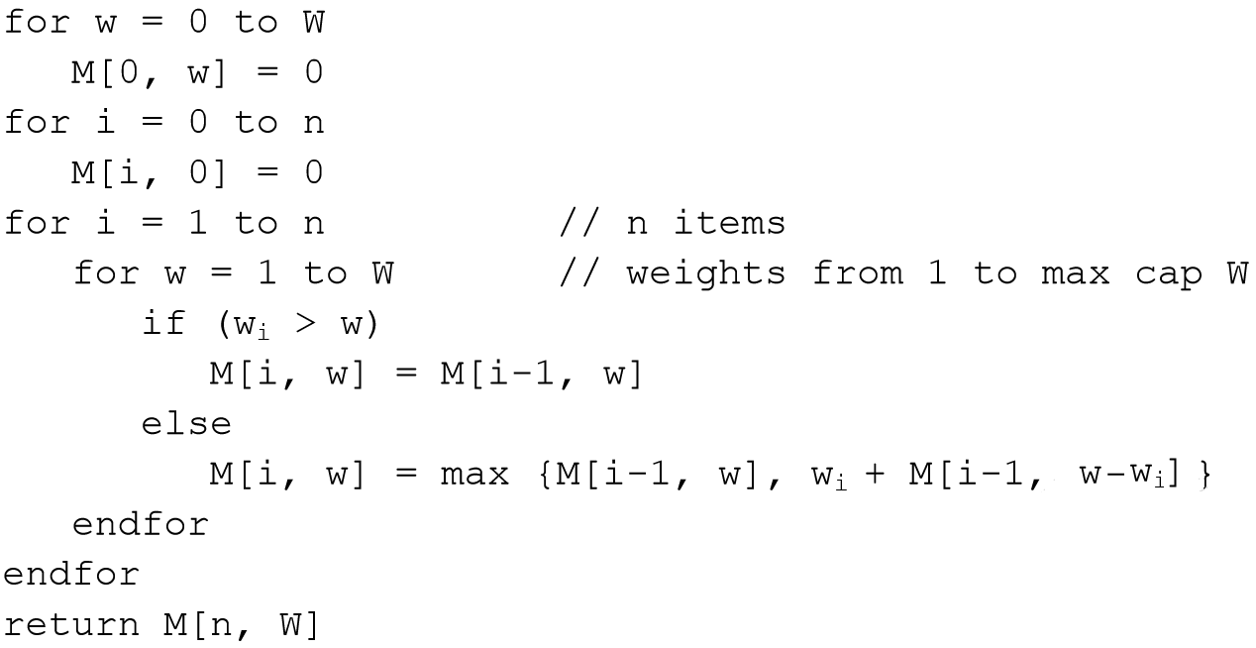
SUBSET – SUM ALGORITHM
//Purpose: To find the maximum weight from the given n items and their weights wi
//Input: A set of items 1,2,…….n, with, w1, … ,wN, capacity W
//Output: Max weight M[n, W]

Slide 7
SUBSET – SUM EXAMPLE
ITEMS | WEIGHTS | W = 5
1 | 2
2 | 1
3 | 3
 | 0 | 1 | 2 | 3 | 4 | 5
0 | 0 | 0 | 0 | 0 | 0 | 0
1 | 0
2 | 0
3 | 0

Slide 8
SUBSET – SUM EXAMPLE
i | wi | w | wi > w | M [i, w]
1 | 2 | 1 | 2 > 1 TRUE | = M[i-1, w] = M[0, 1] = 0
 |  | 2 | 2 > 2 FALSE | = Max{ M[i-1, w], wi + M[i-1, w-wi] } = Max ( M [0 , 2 ] , 2 + M [ 0 , 0 ] ) = Max(0,2) = 2
 | 0 | 1 | 2 | 3 | 4 | 5
0 | 0 | 0 | 0 | 0 | 0 | 0
1 | 0 | 0 | 2
2 | 0
3 | 0

Slide 9
SUBSET – SUM EXAMPLE
i | wi | w | wi > w | M [i, w]
1 | 2 | 3 | 2 > 3 FALSE | = Max{ M[i-1, w], wi + M[i-1, w-wi] } = Max ( M [ 0 , 3 ] , 2 + M [ 0 , 1 ] ) = Max ( 0 , 2 ) = 2
 |  | 4 | 2 > 4 FALSE | = Max{ M[i-1, w], wi + M[i-1, w-wi] } = Max ( M [ 0 , 4 ] , 2 + M [ 0 , 2 ] ) = Max ( 0 , 2 ) = 2
 | 0 | 1 | 2 | 3 | 4 | 5
0 | 0 | 0 | 0 | 0 | 0 | 0
1 | 0 | 0 | 2 | 2 | 2
2 | 0
3 | 0

Slide 10
SUBSET – SUM EXAMPLE
i | wi | w | wi > w | M [i, w]
1 | 2 | 5 | 2 > 5 FALSE | = Max{ M[i-1, w], wi + M[i-1, w-wi] } = Max ( M [ 0 , 5 ] , 2 + M [ 0 , 3 ] ) = Max ( 0 , 2 ) = 2
 | 0 | 1 | 2 | 3 | 4 | 5
0 | 0 | 0 | 0 | 0 | 0 | 0
1 | 0 | 0 | 2 | 2 | 2 | 2
2 | 0
3 | 0

Slide 11
SUBSET – SUM EXAMPLE
i | wi | w | wi > w | M [i, w]
2 | 1 | 1 | 1 > 1 FALSE | = Max{ M[i-1, w], wi + M[i-1, w-wi] } = Max ( M [1 , 1 ] , 1 + M [ 1 , 0 ] ) = Max ( 0 , 1 ) = 1
 |  | 2 | 1 > 2 FALSE | = Max{ M[i-1, w], wi + M[i-1, w-wi] } = Max ( M [1 , 2 ] , 1 + M [ 1 , 1 ] ) = Max ( 2 , 1 ) = 2
 | 0 | 1 | 2 | 3 | 4 | 5
0 | 0 | 0 | 0 | 0 | 0 | 0
1 | 0 | 0 | 2 | 2 | 2 | 2
2 | 0 | 1 | 2
3 | 0

Slide 12
SUBSET – SUM EXAMPLE
i | wi | w | wi > w | M [i, w]
2 | 1 | 3 | 1 > 3 FALSE | = Max{ M[i-1, w], wi + M[i-1, w-wi] } = Max ( M [1 , 3 ] , 1 + M [ 1 , 2 ] ) = Max ( 2 , 3 ) = 3
 |  | 4 | 1 > 4 FALSE | = Max{ M[i-1, w], wi + M[i-1, w-wi] } = Max ( M [1 , 4 ] , 1 + M [ 1 , 3 ] ) = Max ( 2 , 3 ) = 2
 | 0 | 1 | 2 | 3 | 4 | 5
0 | 0 | 0 | 0 | 0 | 0 | 0
1 | 0 | 0 | 2 | 2 | 2 | 2
2 | 0 | 1 | 2 | 3 | 3
3 | 0

Slide 13
SUBSET – SUM EXAMPLE
i | wi | w | wi > w | M [i, w]
2 | 1 | 5 | 1 > 5 FALSE | = Max{ M[i-1, w], wi + M[i-1, w-wi] } = Max ( M [1 , 5 ] , 1 + M [ 1 , 4 ] ) = Max ( 2 , 3 ) = 3
 | 0 | 1 | 2 | 3 | 4 | 5
0 | 0 | 0 | 0 | 0 | 0 | 0
1 | 0 | 0 | 2 | 2 | 2 | 2
2 | 0 | 1 | 2 | 3 | 3 | 3
3 | 0

Slide 14
SUBSET – SUM EXAMPLE
i | wi | w | wi > w | M [i, w]
3 | 3 | 1 | 3 > 1 TRUE | = M[i-1, w] = M [ i – 1 , w ] = M [ 3 – 1 , 1 ] = 1
 |  | 2 | 3 > 2 TRUE | = M[i-1, w] = M [ i – 1 , w ] = M [ 3 – 1 , 2 ] = 2
 | 0 | 1 | 2 | 3 | 4 | 5
0 | 0 | 0 | 0 | 0 | 0 | 0
1 | 0 | 0 | 2 | 2 | 2 | 2
2 | 0 | 1 | 2 | 3 | 3 | 3
3 | 0 | 1 | 2

Slide 15
SUBSET – SUM EXAMPLE
i | wi | w | wi > w | M [i, w]
3 | 3 | 3 | 3 > 3 FALSE | = Max{ M[i-1, w], wi + M[i-1, w-wi] } = Max ( M [2 , 3 ] , 3 + M [ 2 , 0 ] ) = Max ( 3 , 3 ) = 3
 |  | 4 | 3 > 4 FALSE | = Max{ M[i-1, w], wi + M[i-1, w-wi] } = Max ( M [2 , 4 ] , 3 + M [ 2 , 1 ] ) = Max ( 3 , 4 ) = 4
 | 0 | 1 | 2 | 3 | 4 | 5
0 | 0 | 0 | 0 | 0 | 0 | 0
1 | 0 | 0 | 2 | 2 | 2 | 2
2 | 0 | 1 | 2 | 3 | 3 | 3
3 | 0 | 1 | 2 | 3 | 4

Slide 16
SUBSET – SUM EXAMPLE
i | wi | w | wi > w | M [i, w]
3 | 3 | 3 | 3 > 5 FALSE | = Max{ M[i-1, w], wi + M[i-1, w-wi] } = Max ( M [2 , 5 ] , 3 + M [ 2 , 2 ] ) = Max ( 3 , 5 ) = 5
 | 0 | 1 | 2 | 3 | 4 | 5
0 | 0 | 0 | 0 | 0 | 0 | 0
1 | 0 | 0 | 2 | 2 | 2 | 2
2 | 0 | 1 | 2 | 3 | 3 | 3
3 | 0 | 1 | 2 | 3 | 4 | 5

Slide 17
SUBSET – SUM EXAMPLE
ITEMS | WEIGHTS | W = 5
1 | 2
2 | 1
3 | 3
 | 0 | 1 | 2 | 3 | 4 | 5
0 | 0 | 0 | 0 | 0 | 0 | 0
1 | 0 | 0 | 2 | 2 | 2 | 2
2 | 0 | 1 | 2 | 3 | 3 | 3
3 | 0 | 1 | 2 | 3 | 4 | 5
SOLUTION

Slide 18
THANK YOU

